Slide 1
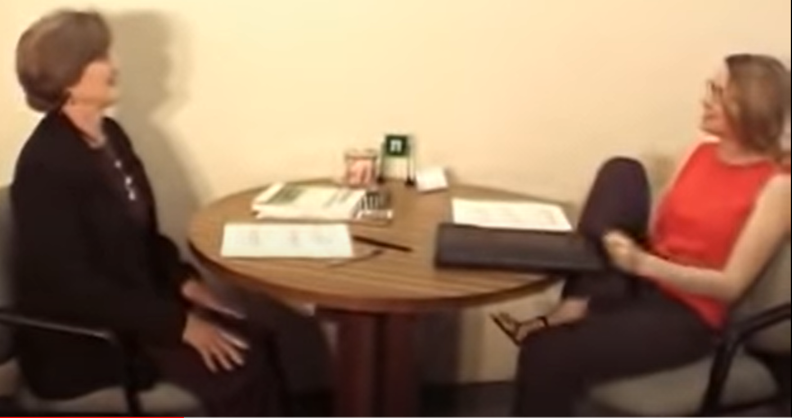
Interview Mistakes
Informal body language
Informal dressing
No preparation
Talking too much
Bad mouthing previous job

Slide 2
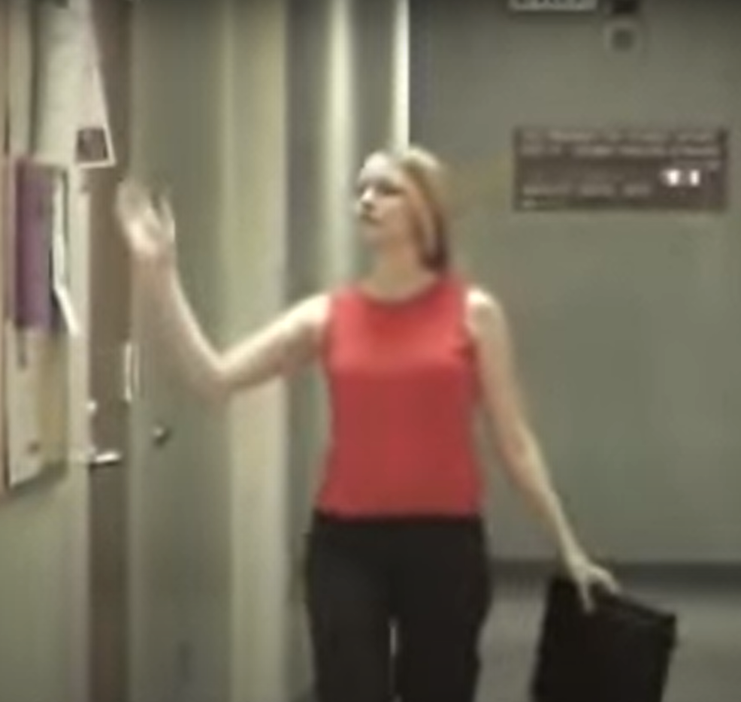
Informal body language
She was eating during the interview
She was telling the interviewer not to question about her qualifications saying everything is mentioned in her resume.
When she was moving towards interview room she slapped the paper on board.

Slide 3
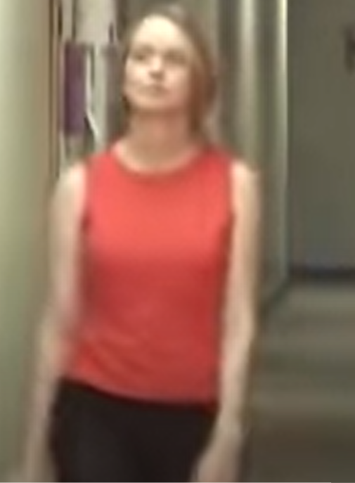
Informal dressing

Slide 4
No preparation
She responded to all the questions with bad impact on her interview
When the interviewer asked about her programming skills she said that she was not good at c++ and java.
When interviewer asked about a team work experience she said that she don’t remember which shows that she didn’t prepared for the interview.

Slide 5
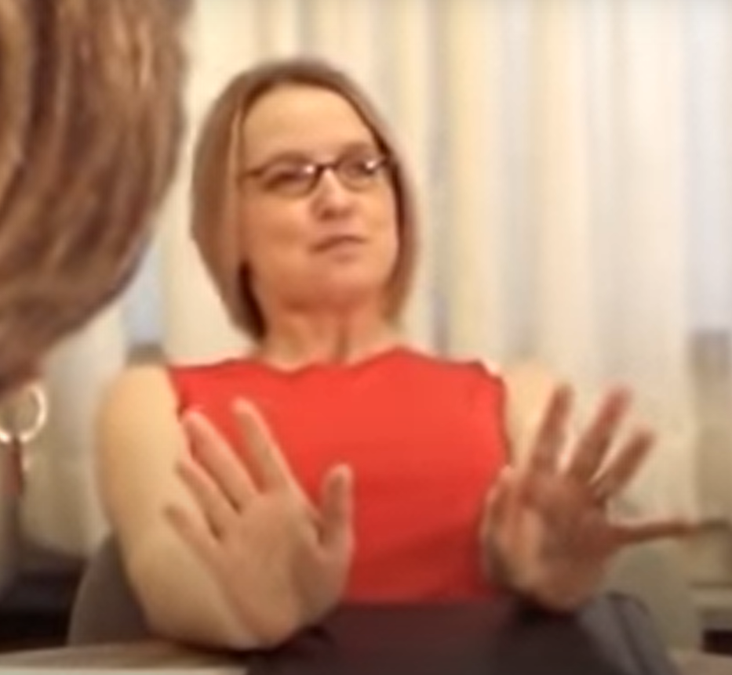
Talking too much
When the interviewer asked her to tell about herself she talked about all the unnecessary things like she is married and have a dog and other things she likes.

Slide 6
Bad mouthing about previous job
She said that where she is currently working she cannot do anything right and called her current boss an idiot and also told that she had beer at work. All of this will have bad impact on her interview.

